Slide 1
Controlling P2P Applications via Address Harvesting: The Skype Story
Anat Bremler-Barr Omer Dekel Ran Goldschmidt Hanoch Levy
Interdisciplinary Center Herzliya Haifa University Tel-Aviv University

Slide 2
Main Contribution
Common belief: P2P applications are harder to control and block
Distributed, propriety protocol, no special port
This paper shows: Skype is vulnerable to a technique of blocking by harvesting the servers that form the control layer
Proof by model and experiments
Reveals new facts about Skype network
2/29

Slide 3
Motivation: Battle of Power - Who controls the traffic ?
War between:
Network Provider Application
ISP or Enterprise:
Enterprise: worries from data leakage ISP: - control bandwidth
- sale VoIP services
P2P application : Skype
- Proprietary (encrypted!) protocol
- Distributed
- Port 80 → hard to control
3/29

Slide 4
Background: Controlling of P2P – current solutions
Application control – you can NOT download Skype in the Enterprise\ISP
Problem : Bypass downloading client while outside the enterprise
Mobile phones and devices.
Signatures on the encrypted traffic – an heuristic approach
Problem : False positive, very sensitive to small changes or randomization in the protocol, heavy processing on the payload of the traffic.
Our solution: Block Skype by mapping the Super Nodes network
Advantages: light processing - filtering according to header fields, zero false positive

Slide 5
Background: Skype Architecture
Based on partially centralized P2P networks
Two types of peer nodes:
Regular Clients and Super Nodes
Super Nodes (SNs):
Control level – heart of Skype
Super Nodes = Skype Clients
with good Bandwidth, CPU usage ...

Slide 6
Background: The Role of a Super Node (SN)
Maintains control information: the IPs of the Skype users
Each client maintains an SN list → subset of SNs
SN list is constantly updated
There are also hard-coded SNs which are Skype servers
Client that wishes to use Skype (to call)
picks one SN from the SN list
Querying the IP of the callee
SN is defined by (IP,Port)
Call Bob

Slide 7
Background: The Role of a Super Node (SN)
Maintains control information: the IPs of the Skype users
Each client maintains an SN list → subset of SNs
SN list is constantly updated
There are also hard-coded SNs which are Skype servers
Client that wishes to use Skype (to call)
picks one SN from the SN list
Querying the IP of the callee
SN is defined by (IP,Port)
Call Bob
IP=12.3.2.4, Port=3

Slide 8
Background: The Role of a Super Node (SN)
Maintains control information: the IPs of the Skype users
Each client maintains an SN list → subset of SNs
SN list is constantly updated
There are also hard-coded SNs which are Skype servers
Client that wishes to use Skype (to call)
picks one SN from the SN list
Querying the IP of the callee
SN is defined by (IP,Port)
Call Bob

Slide 9
Harvesting technique: Harvesting the Entire Super Nodes Layer
Create an SN “black list” by harvesting the whole SNs using small number of clients
FW will block access to the SNs in the “black-list”
Light process with no false positive since SNs are exact IPs and Ports
Client cannot connect to P2P if the system filters all 200 SNs in the SN list
X

Slide 10
Harvesting techniques:
Using Skype client as a black box.
Without any sophisticated reverse engineering.
Two basic techniques:
1. Extracting the SN list:
Using the information from the SN list
Applicable to Skype versions were the SN list is not encrypted.
2. Monitoring the Skype connection:
Manipulate the client to connect to many SNs
Applicable for all Skype versions
10/29

Slide 11
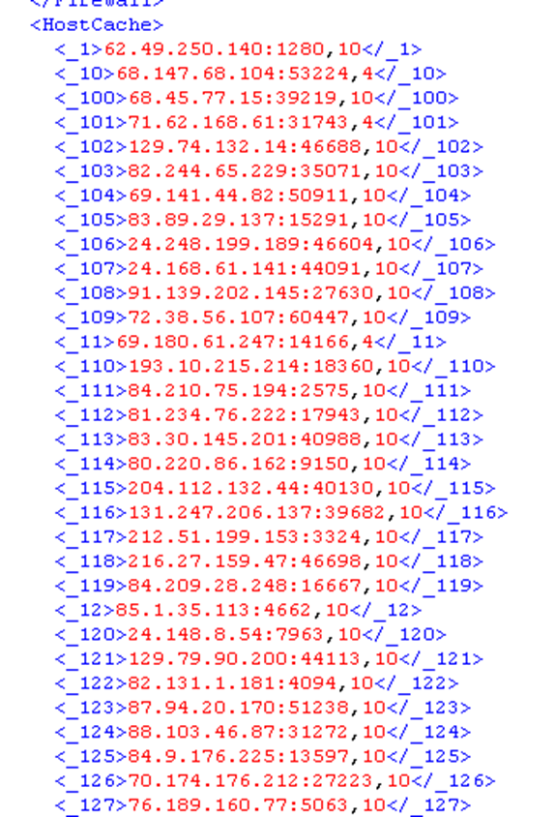
Harvesting technique: Extracting the SN list
SN list:
Version 2-2.5 - SN list is not encrypted.
Contains 200 SNs
Each SN: < IP, Port>
The SN list is constantly updated
Manipulate client so the list will be updated in high rate:
Extracting the SN addresses
Flushing almost the entire SN list, leaving only one SN
Restarting the Skype Client and waiting until the list is refreshed with 200 SN addresses.
Experiment result: Each such round 2 minutes, harvesting up to 200 new SNs

Slide 12
Harvesting technique: Monitoring the Skype connection
Monitor outbound connections of skype client using netstat command
Locate the SN which the client connects to
Block the SN with a local or external firewall and repeat the process
Result: 30 new SNs per minute
12/29

Slide 13
Harvesting technique: Experiment – Extracting the SN list
We concentrate on the first technique :
Extracting the SN list → higher rate of harvesting
Experiment setup:
71 harvesters (harvester=Skype client) located at Israel and Zurich
It is enough to run 3-4 real physical machines. Each one runs around 20 clients by using virtual machine and multi users functionality.
Collected over 40 Million SN addresses
107,000 unique SNs
Run for 80 hours
13/29

Slide 14
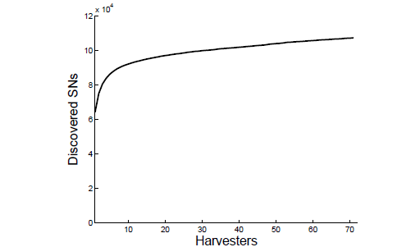
Harvesting technique: Experiment
Process converge
The order of the harvesters was picked randomly, and the result was stable for any order.
Majority of the SNs, were discovered by the first 30 harvesters → the process converge.

Slide 15
Harvesting technique: Experiment
On going process
This is on going process – the population of the SNs is constantly changing
Explanation:
Dynamic nature of P2P clients and SNs (join and leave the network)
46% of the SNs have dynamic IP addresses → an SN that changes
its IP is as a new SN to the system
15/29

Slide 16
Harvesting technique: Measure the blocking probability
Tester – Skype client that simulates the attempts of a regular user to connect to Skype
During the experiment, 12 testers (Israel, Swiss and USA) each performs 240 tests in a period of 4 days
The test
Step 1: Tester preforms login to Skype and retrieves a new SN list
Step 2: Test the capability to connect to Skype = Check if all SNs in the SN list are known to the system
Check 0,10,30 minutes after retrieving the SN list
Step 3: Tester preforms shout down and waits in order to receive a new SN list in order to preform the next test

Slide 17
Harvesting technique: blocking probability
Client is disconnected from Skype if all the SNs in its SN list are known to the system
The average blocking probability is very high: even a fresh list has 94.5% probability
Low dependency on the time that elapsed from retrieving the list until the attempt to connect to Skype

Slide 18
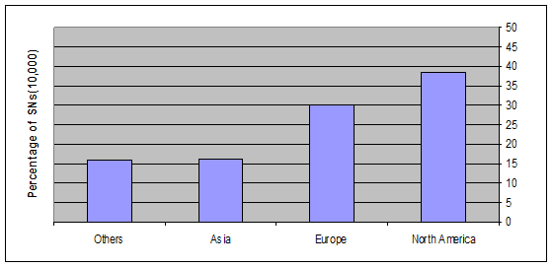
SN population characteristics
Popular SNs
10% of the most frequent SNs covers roughly 80% of the total collected records.
No frequent port
Skype port at the client is chosen randomly
No dominant AS.
SNs are distributed over the world (but more at USA)

Slide 19
Static model
Let M - # SNs in the population – assumption fixed
Let N ~ 200 - # SNs in SN list
Randomly select N distinct objects from the set of M objects.
Return the N objects and again select N distinct objects.
Repeat this process K times.
Question: what is the probability that each of the objects selected at the K + 1st time was selected earlier.
Version of Coupon Collector problem

Slide 20
Analysis of Static Model
Exact solution by recursion
Luckily, approximate solution is a good estimation
N - list
M - population
K - iteration
q = Pr[x is not selected in experiments 1,...,K ] =(1 – N/M)^{K}
20/29

Slide 21
Dynamic model
An IP address remains valid for a period of time ~ ”the life of the address”
In the end of the duration, the address changes and a new address will be valid
The harvesters have time to capture the SN proportional to the age of the address. Age → hard to retrieve.
Residual life ~ age : the two density functions are similar
We measure the residual life density function (and use it).
21/29

Slide 22
Dynamic Nature of SN: Estimation of the residual life density function
Stage 2: Ping each SN every 15 minutes for 3 months
Stage 1: Collecting 5,000 SNs in 15 minutes
Harvesting of SNs: Using the SN list
UDP packet of Skype login
22/29

Slide 23
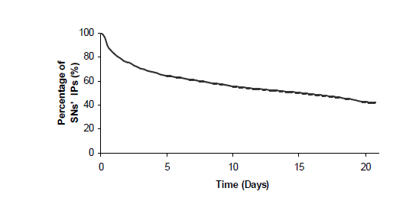
Residual life density function
1st Day: 18% of the SNs died
2nd Day: 8%
3rd Day: 5%
4th Day: 3%
The harvesting process is an on going process mainly due to dynamic affect of IPs

Slide 24
Estimating the population of active SNs
Our goal: estimate the number of SNs in specific time
As far as we know we give here the first estimation
Assumption: fixed population size - M
M × Death rate = new discovered SNs
Result: M × 0.00208 = 9 → M~45,000
# of dead SNs in the first iteration of our test
# new SNs in each harvesting iteration after the process converge

Slide 25
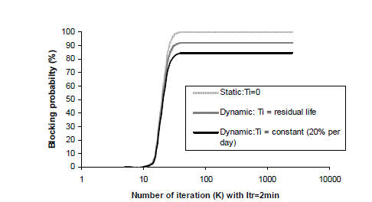
Model Result
Static: 100% after 50 iterations
Harvesters = 71
25/29

Slide 26
Model Result
Dynamic: 92% (~ 95% experiment)
Harvesters = 71
26/29

Slide 27
Skype countermeasures are limited
Possible techniques:
Reducing the updating rate of the SN list
Changing the SN list size
Increasing the population, M
The Harvesting technique can overcome the above countermeasures by increasing the number of harvesters linearly
27/29

Slide 28
Conclusion
In this paper we use measurements and modeling and show that it is feasible to harvest the vast majority of the active SNs of Skype.
This makes Skype vulnerable
We suspect that this vulnerability may be a fundamental problem of P2P networks, despite their distributed nature.
28/29

Slide 29
bremler@idc.ac.il
hanoch@post.tau.ac.il

