Slide 1
Layered Interval Codes for TCAM-based Classification
David Hay, Politecnico di Torino
Joint work with Anat Bremler-Barr (IDC), Danny Hendler (BGU) and Boris Farber (IDC)
This work is supported by a Cisco grant

Slide 2
Outline
Packet Classification and TCAM devices
The range rule representation problem
Our solution: Layered Interval Code
Conclusions

Slide 3
Packet Classification
HEADER
Forwarding Engine
Packet Classification
Action
Policy Database (classifier)
Rule
Action
----
----
----
----
Incoming
Packet
----
----

Slide 4
Multi-field Packet Classification
Given a database with N rules, find the action associated with the highest priority rule matching an incoming packet
Example: A packet (152.168.3.32, 152.163.171.71, …, TCP) would have action A₂ applied to it

Slide 5
Applications
Address Lookup
  Where to send an incoming packet?
  Usually needs only destination IP address
Firewall, ACL, Intrusion Detection Schemes
  Which packet to accept or deny?
  Usually needs 5 fields: source-address, dest-address, source-port, dest-port, protocol
Packet classification lies in the critical path of the
packet, and should be performed at very high rate
(~125 million packets per second for 40 Gb/s network)

Slide 6
Software Solutions
Many exist in the literature:
  Linear Search
  Tree-based (e.g. Trie, Grid of Tries…)
  Cross-producting
  HiCuts
  Bloom-Filter Based Data Structures
  …
All software solutions introduce non-constant
classification time (and we usually have only 1
cycle)

Slide 7
Towards a Hardware Solution
Rules in the policy database can be written in a ternary alphabet, using 0,1,∗
In the 5-field IPv4 rules (for firewall, ACL…), we can represent each rule as a string of 104 ternary symbols
100110001010100000000011∗∗∗∗∗∗∗∗

Slide 8
Packet Classification w/ TCAM
0
deny
0
1
deny
1
2
accept
2
TCAM Array
Each entry is a word in {0,1,∗}^{W} and represents a rule
accept
3
2
3
4
accept
4
Encoder
deny
5
5
6
deny
6
7
deny
7
8
deny
8
accept
9
9
Match lines
5-Field Packet Header (Search Key)
Notes:
Why Packet Classification in IP; first match; Any router/firewall. Alternative data structures in software (list, tree, trie). No deterministic latency.
Example

Slide 9
Example
0
deny
0
0011101101010∗∗00∗01001111∗∗∗∗
11∗00∗00001110∗0∗101000110∗∗∗∗
0
deny
1
10∗∗010100∗0∗∗0100011010∗01000
0
accept
2
1
3
deny
3
001110∗∗∗∗∗∗∗∗∗∗∗∗∗∗∗∗∗∗∗∗∗∗∗∗∗
1110∗∗010∗01∗0010101010∗0∗∗∗∗∗
0
log
4
Encoder
0
deny
5
11∗∗10010∗01∗0010∗∗∗∗10∗01∗∗∗∗
∗∗∗∗∗∗∗∗∗∗∗∗∗∗∗∗∗∗∗∗∗∗∗∗∗001110
1
deny
6
∗∗∗∗10101010∗∗∗∗∗∗∗∗∗∗∗∗∗∗∗∗∗∗∗
1
limit
7
∗∗∗∗111111111111111111111111∗
0
deny
8
∗∗∗∗∗∗∗∗∗∗∗∗∗∗∗∗∗∗∗∗∗∗∗∗∗∗∗∗∗∗∗
1
accept
9
Match lines
0011101010101001110001110001110

Slide 10
TCAM Benefits and Disadvantages
Deterministic Search Throughput—O(1) search
  Extremely important
  The only real solution that can do that
However, relatively costly and power consuming
  150$ for small (4Mbit) TCAM
~10 millions TCAM devices already deployed
Notes:
Free extra symbol is picture

Slide 11
Typical Dimensions and Speed
100K-200K rules
100-150 symbols per rule
Deterministic Search Throughput—O(1) search
133 million searches per second for 144-bit keys
  Suitable even for 40 Gb/s IPv4 traffic
Few dozens (~40) extra symbols are left in each entry, that can be used to optimize TCAM performance

Slide 12
Outline
Packet Classification and TCAM devices
The range rule representation problem
Our solution: Layered Interval Code
Conclusions

Slide 13
Range Rules
Rule | Source address | Source port | Dest-address | Dest-port | Protocol | Action
Rule 1 | 123.25.0.0/16 | 80 | 255.2.3.4/32 | 80 | TCP | Accept
Rule 2 | 13.24.35.0/24 | >1023 | 255.2.127.4/31 | 5556 | TCP | Deny
Rule 3 | 16.32.223.14 | 20-50 | 255.2.3.4/31 | 50-70 | UDP | Accept
Rule 4 | 22.2.3.4 | 1-6 | 255.2.3.0/21 | 20-22 | TCP | Limit
Rule 5 | 255.2.3.4 | 12-809 | 255.2.3.4 | 17-190 | ICMP | Log
Range rule = rule that contains range field
  Usually source-port or dest-port
  E.g., all packets with dest-port [1024,2¹⁶-1] are denied

Slide 14
Range Rules Representation
Some ranges are easy to represent
  [20, 23] = {10100,10101,10110,10111} = 101∗∗
But what about [1,6]?

Slide 15
Prefix Expansion
[Srinivasan, Varghese, Suri, Waldvogel; 1998]
Use multiple entries to code a single rule
[1,6]= {001, 01∗,10∗, 110} – 4 entries
Every rule that contains [1,6] needs 4 entries
  Maximum expansion 2W-2 for range [1,2^{W}-2]
  (W is the field width)
Rule | Source address | Source port | Destination address | Destination port | Protocol | Action
Rule 1 | 123.25.0.0/16 | 80 | 255.2.3.4/32 | 80 | TCP | Accept
Rule 2 | 13.24.35.0/24 | >1023 | 255.2.127.4/31 | 5556 | TCP | Deny
Rule 3 | 16.32.223.14 | 20-50 | 255.2.3.4/31 | 50-70 | UDP | Accept
Rule 4.1 | 22.2.3.4 | 1 | 255.2.3.0/21 | 20-22 | TCP | Limit
Rule 4.2 | 22.2.3.4 | 2-3 | 255.2.3.0/21 | 20-22 | TCP | Limit
Rule 4.3 | 22.2.3.4 | 4-5 | 255.2.3.0/21 | 20-22 | TCP | Limit
Rule 4.4 | 22.2.3.4 | 6 | 255.2.3.0/21 | 20-22 | TCP | Limit
Rule 5 | 255.2.3.4 | 12-809 | 255.2.3.4 | 17-190 | ICMP | Log
Notes:
Illustrate two range fields

Slide 16
Prefix Expansion
For rules with two range fields, we need the Cartesian product of the expansion
In real TCAMs cause 6 times more entries!
  More power, more memory, more potential errors
Active research to reduce this cost:
[Liu], [van-Lunteren, Engbersen], [Lakshminarayanan, Rangarajan, Venkatachary], [Yu, Katz], [Spitznagel, Taylor and Turner], [Che, Wang, Zheng, Liu]…

Slide 17
Using the Extra Symbols
[Liu]
Suppose there is only one field with ranges
R₁= [1,6] ;
R₂ = [1,600] ;
R₃ = [500,600] ;
R₄ =[1024,2¹⁶-1]
Using 4 extra symbols:
R₁ = 1∗∗∗ ;
R₂ = ∗1∗∗ ;
R₃ = ∗∗1∗ ;
R₄ = ∗∗∗1
Rule | Source address | Source port | Pro.
Rule 1 | 123.25.0.0/16 | <601 | TCP
Rule 2 | 13.24.35.0/24 | >1023 | TCP
Rule 3 | 16.32.223.14 | 500-600 | UDP
Rule 4 | 22.2.3.4 | 1-6 | TCP
Rule 5 | 22.2.3.4 | 550 | TCP
Rule 6 | 255.2.3.4 | >1023 | ICMP
Rule 7 | 13.24.35.0/24 | >1023 | TCP
Rule 8 | 168.0.0.0/8 | 1-6 | UDP
Rule 9 | 192.132.4.0 | 500-600 | UDP

Slide 18
Using the Extra Symbols
[Liu]
Suppose there is only one field with ranges
R₁= [1,6] ;
R₂ = [1,600] ;
R₃ = [500,600] ;
R₄ =[1024,2¹⁶-1]
Using 4 extra symbols:
R₁ = 1∗∗∗ ;
R₂ = ∗1∗∗ ;
R₃ = ∗∗1∗ ;
R₄ = ∗∗∗1
Rule | Source address | Source port | Pro.
Rule 1 | 123.25.0.0/16 | ********* | TCP | *1**
Rule 2 | 13.24.35.0/24 | ********* | TCP | ***1
Rule 3 | 16.32.223.14 | ********* | UDP | **1*
Rule 4 | 22.2.3.4 | ********* | TCP | 1***
Rule 5 | 22.2.3.4 | 550 | TCP | ****
Rule 6 | 255.2.3.4 | ********* | ICMP | ***1
Rule 7 | 13.24.35.0/24 | ********* | TCP | ***1
Rule 8 | 168.0.0.0/8 | ********* | UDP | 1***
Rule 9 | 192.132.4.0 | ********* | UDP | **1*

Slide 19
Using the Extra Symbols
[Liu]
For each source port x and range R_{i} compute if x∈R_{i .} which ranges I
For x=550, we get
x ∉ [1,6] ;
x ∈ [1,600] ;
x ∈ [500,600] ;
x ∉ [1024,2¹⁶-1]
Extra Symbols assigned: 0110
Rule | Source address | Source port | Pro.
Rule 1 | 123.25.0.0/16 | ********* | TCP | *1**
Rule 2 | 13.24.35.0/24 | ********* | TCP | ***1
Rule 3 | 16.32.223.14 | ********* | UDP | **1*
Rule 4 | 22.2.3.4 | ********* | TCP | 1***
Rule 5 | 22.2.3.4 | 550 | TCP | ****
Rule 6 | 255.2.3.4 | ********* | ICMP | ***1
Rule 7 | 13.24.35.0/24 | ********* | TCP | ***1
Rule 8 | 168.0.0.0/8 | ********* | UDP | 1***
Rule 9 | 192.132.4.0 | ********* | UDP | **1*
550
0110

Slide 20
Using the Extra Symbols
[Liu]
For each source port x and range R_{i} compute if x∈R_{i .} which ranges I
For x=550, we get
x ∉ [1,6] ;
x ∈ [1,600] ;
x ∈ [500,600] ;
x ∉ [1024,2¹⁶-1]
Extra Symbols assigned: 0110
Rule | Source address | Source port | Pro.
Rule 1 | 123.25.0.0/16 | ********* | TCP | *1**
Rule 2 | 13.24.35.0/24 | ********* | TCP | ***1
Rule 3 | 16.32.223.14 | ********* | UDP | **1*
Rule 4 | 22.2.3.4 | ********* | TCP | 1***
Rule 5 | 22.2.3.4 | 550 | TCP | ****
Rule 6 | 255.2.3.4 | ********* | ICMP | ***1
Rule 7 | 13.24.35.0/24 | ********* | TCP | ***1
Rule 8 | 168.0.0.0/8 | ********* | UDP | 1***
Rule 9 | 192.132.4.0 | ********* | UDP | **1*
  Pre-computed and stored in a SRAM direct-access array of 2¹⁶ entries.
550
0110

Slide 21
Flow of information
SRAM
0
Packet Header
x
x
If x∈R_{i} set the i-th bit to 1,
otherwise 0.
For x=550 we get 0110
2¹⁶-1
Notes:
How does it really work? An example

Slide 22
Problems with the Liu’s scheme
Number of ranges usually exceeds the number of symbols → Cannot encode all the ranges → Degrades to prefix expansion
First solution: encode layers with large penalty first [DRES, 2008]
Our contributions: We observe that n non-intersecting ranges can be encoded using log n bits
Using layering technique in order to achieve (much) better range encoding.
w(r) = (# rules with r) × (prefix-expansion(r) – 1)

Slide 23
Encoding Ranges
We look at all ranges as intervals over [0,2¹⁶-1]
0
2¹⁶-1

Slide 24
Encoding Ranges - Layering
Partitioning the ranges to layers of disjoint intervals
Each layer gets its own set of symbols
Ranges are encoded starting from (binary) 1
  ⎡log(n+1)⎤ symbols per n-ranges layer
1 symbol
1
1 symbol
1
2 symbols
01
10
11
3 symbols
001
010
011
100
0
2¹⁶-1

Slide 25
Encoding the Ranges
Extra symbols of the layer: range code
Extra symbols of other layers: ∗∗∗…∗∗∗
∗∗∗10∗∗
1 symbol
1
1 symbol
1
2 symbols
01
10
11
3 symbols
001
010
011
100
0
2¹⁶-1
Notes:
And what if I have only 3 symbols..

Slide 26
Encoding the SRAM Array
For each layer:
  If x is in any interval → the interval code
  If x is not in the interval → all 0’s
x
0010010
∗∗∗10∗∗
0010010
001∗∗∗∗
1 symbol
1
1 symbol
1
2 symbols
01
10
11
3 symbols
001
010
011
100
x
0
x
2¹⁶-1

Slide 27

Towards an Optimal Encoding
Let L₁,L₂,…,L_{n} be the sizes of the layers
The number of bits needed to encode all ranges is
It is NP-hard to find an optimal layering given a set of ranges
  By reduction from circular-arc graph coloring
  2-Approximation algorithm based on maximum size k-colorable sets (MSCS)
  Greedy heuristic colors iteratively maximum size independent set (MSIS)

Slide 28
Coping with “Symbol Budget”
Not all the ranges can be encoded
We use the DRES weight in order to choose the encoded ranges
  Other ranges will be treated with prefix expansion
Given a number of symbols, it is NP hard to find a layering that maximizes the total weight of encoded ranges
  Heuristics take into account the weight
  MWIS, MWCS

Slide 29


Choosing the Right Ranges
Layering Stage
MSIS, MSCS,
MWIS, MWCS
Within each layer, ranges are sorted by their weight; L_{ij} is the j^{th} range of layer L_{i}
We allocate the symbols one by one.
Symbol Allocation Stage
Bit Auction algorithm
Average per-symbol gain for encoding
the next k-symbols to layer L_{i}:
Encoding Stage
Unencoded range rules are
handled w/ Prefix Expansion
Pick the layer with maximum gain,
and assign it the next symbol.

Slide 30
Experimental Results
On real-life rule set
  120 separate rule files from various applications
    Firewalls, ACL-routers, Intrusion Prevention systems
  223K rules
  280 unique ranges
Used as a common benchmark in literature

Slide 31
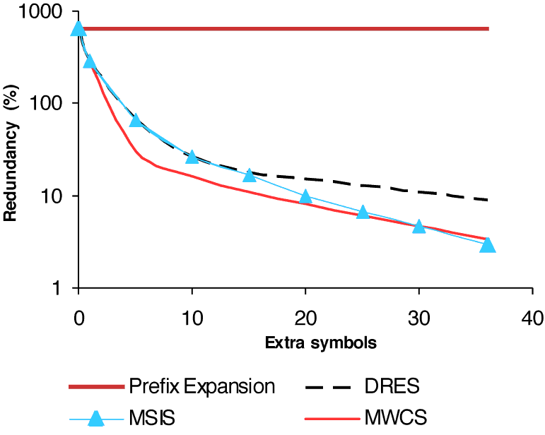
Experimental Results
Best Prior Art

Slide 32
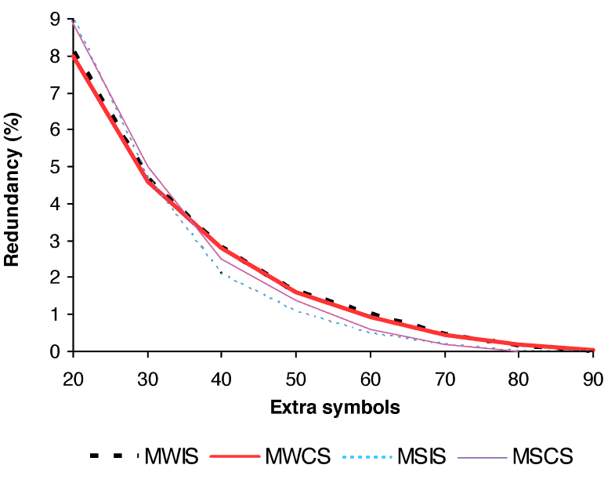
Experimental Results

Slide 33
Wrap-Up
New solution for range representation
  60% better than prior art
Also deals with:
  Two range fields
  Hot updates of the rules
Future work: IPv6
  32-bits for source-, dest- port fields
  Direct access array in SRAM is infeasible
  Possible solution: use TCAM twice in pipelined manner

Slide 34
Wrap-Up
Two solutions for major contemporary challenges in TCAM devices
Makes packet classification more efficient (less entries → less power) and robust
Both solutions make use of extra symbols available in TCAM configurations anyway
An Interesting future direction:
  Using TCAMs outside a networking environment

Slide 35
Thank You

