Slide 1
Efficient Processing of Multi-Connection Compressed Web Traffic
Yaron Koral¹
with: Yehuda Afek¹ , Anat Bremler-Barr¹*
1 Blavatnik School of Computer Sciences Tel-Aviv University, Israel
2 Computer Science Dept. Interdisciplinary Center, Herzliya, Israel
⋆ Supported by European Research Council (ERC) Starting Grant no. 259085

Slide 2
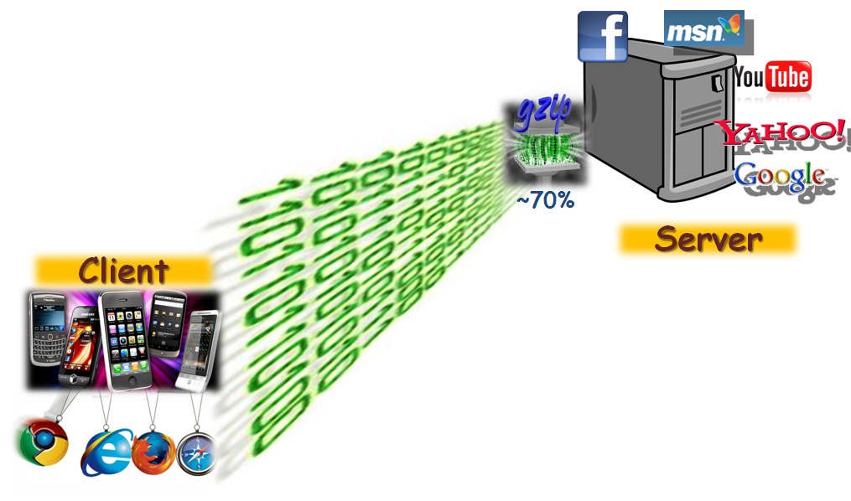
Compressed Web Traffic
Compressed web traffic increases in popularity

Slide 3
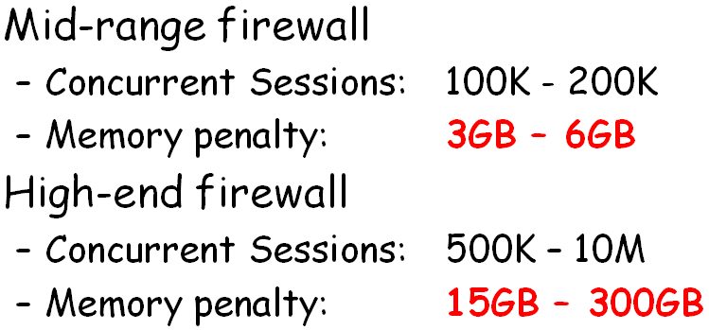
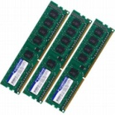
DPI on Compressed Web Traffic
Thousands concurrent sessions
Compressed (Mem. Req. 32KB per Session)
Uncompressed Traffic
DPI
unzip
Contribution:
Space
Time
Improve
80%
40%

Slide 4
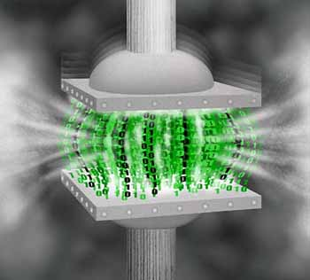
Background: Compressed HTTP uses GZIP
Two stage algorithm:
Stage 1: LZ77
Goal: reduce string presentation size
Technique: repeated strings compression
Stage 2: Huffman Coding
Goal: reduce the symbols code size
Technique: frequent symbols → fewer bits
Notes:
So I’ll start with some background about GZIP
GZIP is combined from two compression algorithms: LZ77 & Huffman coding
LZ77 main goal is to reduce string presentation size by replacing repeated strings in text with pointers
Huffman coding main goal is to reduce coding size by giving frequent symbols, fewer bits representation

Slide 5
Background: LZ77 Compression
Compress repeated strings
Looking only 32KB back (window)
Encode repeated strings by {distance,length}
ABCDEFABCD →
ABCDEF
{6,4}
Pointers might be recursive
Notes:
For our acceleration algorithm we use the LZ77 characteristics, so I’ll speak more about the LZ77 part.
LZ77 replaces repeated strings from the last 32KB window with a pointer.
The pointer is a distance length pair, while distance indicates the number of bytes to go backward and length indicates the number of bytes to copy from that position.
In this example we see a pointer that replaces the repeated string ABCD.
Another important issue is that Pointers may point to other previous pointers recursively.

Slide 6
Background: LZ77 Compression
Decompression is cheap
Copy consecutive bytes to buffer
Enjoys cache boost due to spatial locality
Compression is expensive
Maintain locations of previous strings triplets
Locate (a larger) prior occurrence of current text...
We use this observation later on…

Slide 7
Current state
New Packet
active session buffer
Uncompressed
unzip

Slide 8
General Idea: Keep “compressed” buffer
New Packet
active session buffer
Compressed
Keep buffers in a “compressed” form
Uncompress “active session” only
unzip

Slide 9
1st attempt – use original data
Problem: pointers may point out-of buffer boundary
Distance between a pointer to its literals may be the entire session!
This usually exceeds 32KB…
Packets
32KB Buffer
hello… …
…(300,5) …abc…
… (200,3)…
(30,000,4)......
INVALID!

Slide 10
2nd attempt – re-compress buffer
Upon new packet arrival
Unzip old buffer
Unzip packet
Process data
Calculate new buffer boundary
gzip buffer
Pro’s:
Space efficient: 83% less memory
Con’s:
Time expansive: 20 times slower!!!
TIME
EXPANSIVE!!

Slide 11
Our solution: Swap Out of boundary Pointers (SOP)
Buffer PACKING Technique – Light Compression
SOP uses the original GZIP compressed form (as in 1st attempt)
Swap invalid pointer with its referred literals
SOP Compared to 2nd attempt:
Space 2.6% more memory
Time: 81.4% faster

Slide 12
How it works
(a) Compressed Buffer
hello… …
…(300,5) …abc…
… (200,3)…
(30,000,4)......
(b) Uncompressed Buffer
hello… …
… hello …abc…
… abc …
ello … ...
(c) SOP Buffer
hello… …
… hello …abc…
… (200,3)…
(30,000,4)…...

Slide 13
SOP – Packing Algorithm
Upon new packet arrival
Unzip old buffer
Unzip packet
Process data
Calculate new buffer boundary
Swap out-of boundary pointers with literals
5.Swap pointer with literals
New Packet
1.unzip
2.unzip
4.New boundary

Slide 14
SOP – Time Considerations
Each packet is decompressed several times
Uncompressed size ~ 4.6KB (→ 32/4.6=6.9)
Decompression is cheap! (still…)
Gzip Decompression
time

Slide 15
SOP-Indexed
Keep indices to chunks within buffer
Decompress only required chunks
SOP-Indexed as compared SOP
Space loss: 5.8%
Time gained: 10.3%
Chunk
Indices
New Packet
1.Unzip req. chunks
2.unzip

Slide 16
DPI of Compressed Traffic
ACCH: Aho-Corasick based algorithm for Compressed HTTP (INFOCOM 2009)
General Idea: skip scanning repeated-strings
Memory Req.: 2-bit status vector per byte
32KB
40KB

Slide 17
ACCH Algorithm: skip scanning pointer area
Aho-Corasick
DPI Scan
ACCH
Skips around 80% of data scans
Status-vector increases space requirement by 25%
Solution: Pack Vector with Data

Slide 18
Experimental Results: Packing Methods
 | Avg. Buffer Size | Normalized Packing Time
Naïve (Plain) | 29.9KB | 1
OrigComp (1st attempt) | 4.54KB | -
Recompress (2nd attempt) | 5.04KB | 20.77
SOP | 5.17KB | 3.85
SOP-Indexed | 5.47KB | 3.49

Slide 19
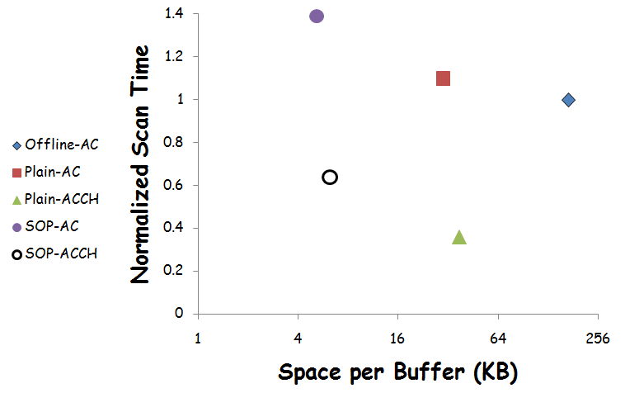
Experimental Results: DPI +Packing
Unzip entire session.
Avg. Size = 170KB
SOP
1.39, 5.17KB
SOP+ACCH
0.64, 6.19KB
Naïve
1.1, 29KB
ACCH 0.36, 37.4KB

Slide 20
Conclusion
HTTP compression - gains popularity
High memory requirements ➔ ignored by FWs
SOP reduces space requirement by over 80%.
SOP with ACCH 80% less memory
and 40% faster.

