Slide 1
Fast Pattern Matching in Non-Linear Tone-Mapped Images
Yacov Hel-Or
The Interdisciplinary Center (IDC), Israel
Visiting Scholar - Google
Hagit Hel-Or and Eyal David
U. of Haifa, Israel

Slide 2
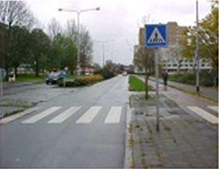
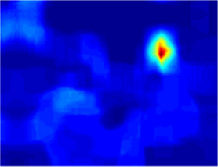
Pattern Matching under Tone Mapping
A given pattern p is sought in an image.
The pattern may appear at any location in the image.
The image may be subject to some tone changes.
pattern
image
similarity

Slide 3
Pattern Matching
Source of Tone Changes:
Illumination conditions
Camera parameters
Different Modalities
Applications: “patch based” methods
Image summarization
Image retargeting
Image editing
Super resolution
Tracking, Recognition, many more …

Slide 4
Tone Changes as Tone Mappings
Assumption: Tone changes can be locally represented as a Tone Mapping between the sought pattern p and a candidate window w:
V_{w}
w=M(p)
or
p=M(w)
V_{p}
V_{p}

Slide 5
Distance Metric
Given a pattern p and a candidate window w a distance metric must be defined, according to which matchings are determined:
Desired properties of D(p,w) :
Discriminative
Robust to Noise
Invariant to some deformations: tone mapping
Fast to execute
D(p,w)

Slide 6
Most Common Distance Metrics
Sum of Squared Difference (SSD):
By far the most common solution.
Assumes the identity tone mapping.
Fast implementation (~1 convolution).

Slide 7
Normalized Cross Correlation (NCC):
Compensates for linear mappings.
Fast implementation (~ 1 convolution) .

Slide 8
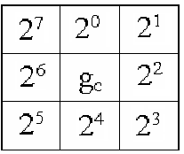
Ordinal Coding (LBP, SURF, BRIEF):
Each pixel is assigned a value representing its surrounding structural content.
Compensates for monotonic mappings.
Fast implementation.
Sensitive to noise.

Slide 9
Mutual Information (MI):
Measures the statistical dependencies between p and w.
Compensates for non-linear mappings.
D(p,w)=I(p,w)=H(w)-H(w | p)
H(p)
H(w)

Slide 10
MI as a Distance Measure:
Properties:
Measures the entropy loss in w given p.
Highly Discriminative.
Sensitive to bin-size / kernel-variance.
Inaccurate for small patched.
Very slow to apply.
I(w,p)
H(w)
H(p)

Slide 11
Proposed Approach: Matching by Tone Mapping (MTM)
Properties:
Highly discriminative.
Invariant to any (non-linear) tone mapping.
Robust to noise.
Very fast to apply.
Natural generalization of the NCC for non-linear mappings.

Slide 12
Matching by Tone Mapping (MTM)
Proposed distance measure:
Note: the division by var(w) avoids the trivial mapping.

Slide 13
How can MTM be calculated efficiently?
Basic Ideas:
Approximate M(p) by a piece-wise constant mapping.
Enables to represent M(p) in a linear form.
The minimization can be solved in closed form.
V_{w}
V_{w}
V_{p}
V_{p}

Slide 14
Tone Mapping as a linear form:
Assume the pattern/window values are restricted to the half open interval [a,b).
We divide [a,b) into k bins α=[α₁,α₂,...,α_{k+1}]
A value z is naturally associated with a single bin:
B(z)=j if z∈[α_{j},α_{j+1})
α₁
α₂
α_{j}
α_{j+1}
α_{k+1}
z

Slide 15
Pattern Slices
We define a pattern slice

Slide 16
Pattern Slices
0
1
2nd slice p²
1st slice p¹
We define a pattern slice

Slide 17
The Slice Matrix
= S_{p}
Raster scanning the slice windows and stacking into a matrix constructs a slice matrix S_{p} =[p¹ p² … p^{k}].

Slide 18
S_{p} α ≈ p
*
≈
The matrix S_{p} is orthogonal: p^{i}⋅p^{j} = |p^{i}| δ_{ij}
Its columns span the space of piecewise constant tone mappings of p:
S _{p} α ≈ p

Slide 19
α
S_{p} ≈
p
β
M(p)
*
≈
Changing the α values to a different vector, β, applies piece-wise tone mapping:
S _{p} β ≈ M(p)

Slide 20
Back to Pattern Matching
Representing tone mapping in a linear form, D(p,w) boils down to:
The above minimization can be solved in closed form:

Slide 21
D( , )= ( )
•
-( )
p
w
2
•
-( )
2
•
-( )
2
•
…

Slide 22
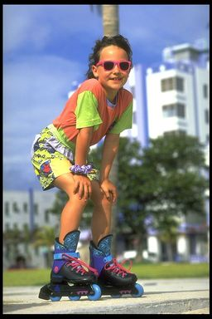
MTM for running windows:
2
( )
*
box filter
( )
2
*
Pattern

Slide 23
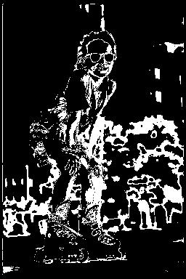
MTM for running windows:
p² :
( )
2
*
Pattern

Slide 24
Complexity
Convolutions can be applied efficiently since p^{j} is sparse.
Convolving with p^{j} requires |p^{j}| operations.
Since p^{i}∩p^{j}=∅ run time for all k sparse convolutions sum up to a single convolution!

Slide 25
MTM and Other Distances
The MTM can be shown to measure:
This is related to the Correlation-Ratio distance measure (Pearson 1930, Roche et al. 1998) and the Fisher’s LD.
Restricting M to be a linear tone mapping: M(z)=az+b, the MTM distance D(w,p) reduces to the NCC.

Slide 26
MTM and MI
MTM and MI are similar in spirit:
While MI maximizes the entropy reduction in (w | p) MTM maximizes the variance reduction in (w | p).
However, MTM outperforms MI with respect to speed and accuracy (in small patch cases).
 | MI | MTM
Maximizes | Entropy reduction | Variance reduction
Speed | slow | Very fast
Bin size | sensitive | insensitive

Slide 27
Results

Slide 28
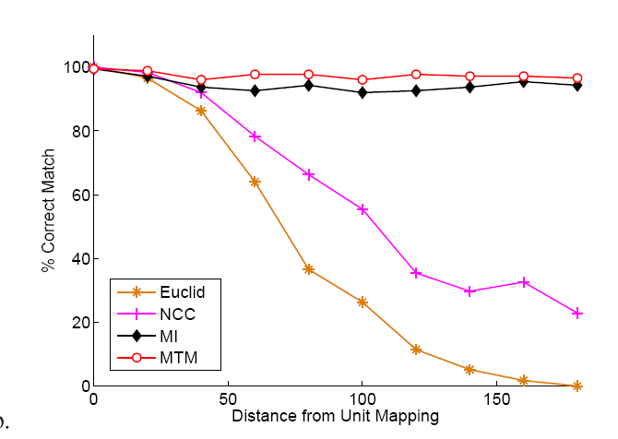
Detection rates (over 2000 image pattern pairs)
v.s extremity of the applied tone mapping.

Slide 29
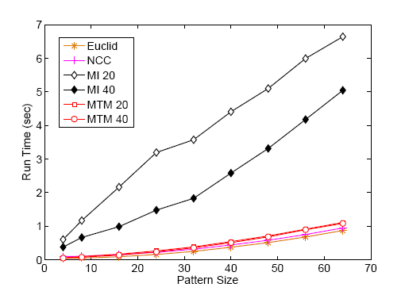
Run time for various pattern sizes (in 512x512 image)

Slide 30
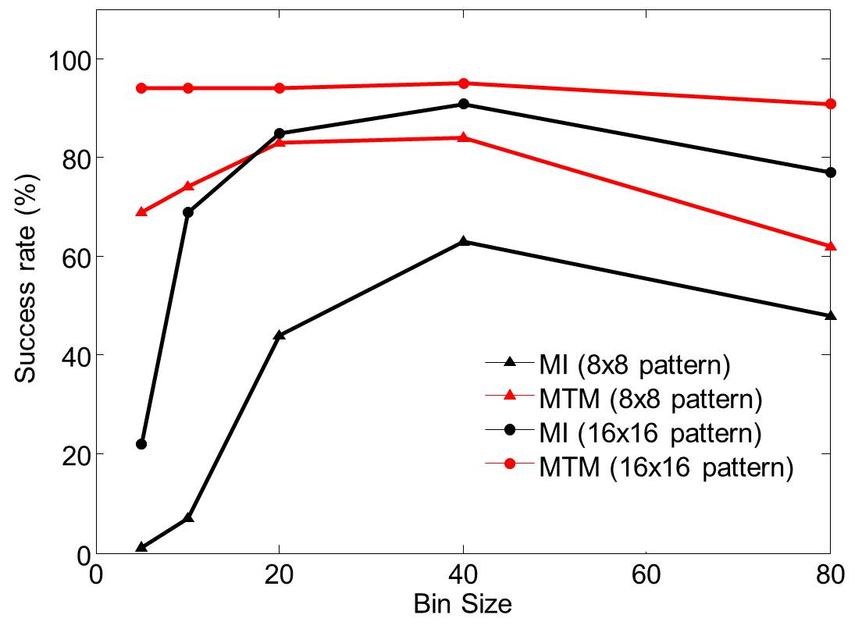
Performance of MI and MTM for various pattern sizes and over various bin-sizes

Slide 31
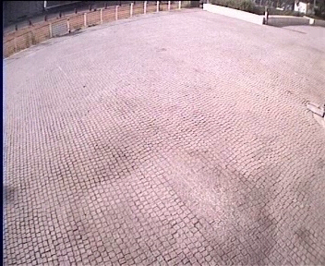
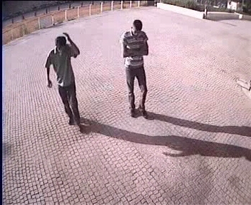
Example Application: Shadow Detection in Video
How can we distinguish between target and background?
Background model
Current video frame

Slide 32
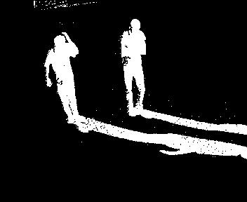
Naïve Background Subtraction

Slide 33
Assumption: Shadow patches are functionally dependent on the background patches.
Background model
Video frame

Slide 34
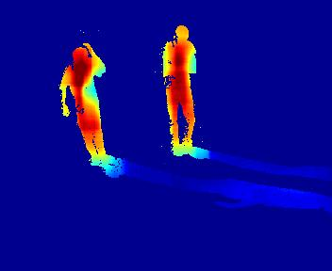
MTM distance

Slide 35
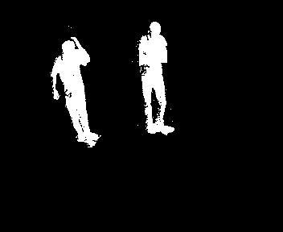
MTM distance

Slide 36
Conclusions:
A new distance measure that accounts for non-linear tone mappings.
A very efficient scheme which can be applied over the entire image using ~1 convolution.
A natural generalization of NCC.

Slide 37
Thank You

