Slide 1

Matching by Mapping
Yacov Hel-Or
I.D.C.
Visiting Scholar – Google
joint work with
Hagit Hel-Or and Eyal David
U. of Haifa, Israel

Slide 2

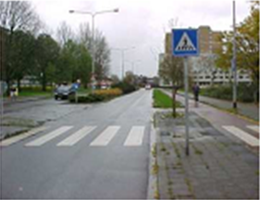
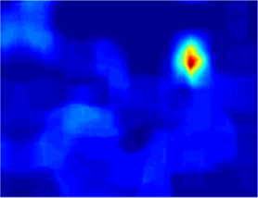
Dense Pattern Matching
A given pattern p is sought in an image.
The pattern may appear at any location in the image.
The pattern may be subject to some deformations T(p).
pattern p
image
similarity map

Slide 3
Possible Deformations
Geometric deformations:
  Different point of views
  Different articulated poses
Photometric deformations:
  Different camera’s photometric parameters (exposure, white balancing, sensor’s sensitivity, tone correction, etc.)
  Different illuminant colors
  Different lighting geometry

Slide 4
Pattern Matching
Serves as a building block in many applications.
Applications: “patch based” methods
  Image summarization
  Image retargeting
  Super resolution
  Image denoising
  Tracking, Recognition, many more …

Slide 5
Dealing with Deformations
Invariance
  Find a signature that will be invariant to the deformation.
  Lose information. Weaken discriminative power.
Canonization
  Transform into canonical position.
  Slow.
Brute force search
  Search the entire deformation space.
  Slow

Slide 6
Pattern matching under
Tone Mapping
In this work we deal only with tone mapping deformation.
Commonly can be locally represented as a functional relationship between the sought pattern p and a candidate window w:
V_{w}
w=M(p)
or
p=M(w)
V_{p}
V_{p}

Slide 7
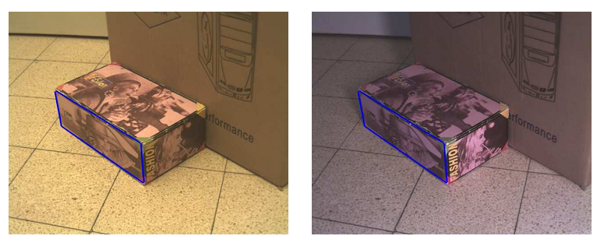
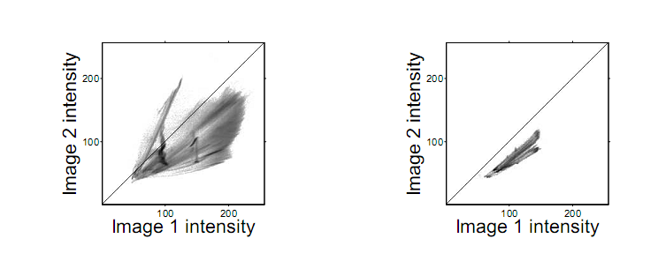
From Kagarlitsky, Moses, and Hel-Or, ICCV 2010.
Joint histograms of two images taken under different illumination conditions and different camera photometric parameters.

Slide 8
Distance Metric
Given a pattern p and a candidate window w a distance metric must be defined, according to which matchings are determined:
Desired properties of D(p,w) :
  Discriminative
  Robust to Noise
  Invariant to some deformations: tone mapping
  Fast to execute
D(p,w)

Slide 9
Possible Tone Mappings
identity mapping
affine mapping
monotonic mapping
non-monotonic mapping

Slide 10
Common Distance Metrics
Sum of Squared Difference (SSD):
  By far the most common solution.
  Assumes the identity tone mapping.
  Fast implementation (~1 convolution).

Slide 11
Normalized Cross Correlation (NCC):
  Compensates for affine mappings (canonization).
  Fast implementation (~ 1 convolution) .

Slide 12
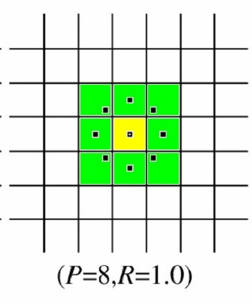
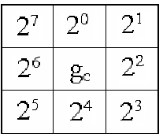
Local Binary Pattern (LBP): Ojala et al. 96
  Each pixel is assigned a value representing its surrounding structural content.
  Compensates for monotonic mappings.
  Fast implementation.
  Sensitive to noise.

Slide 13
Mutual Information (MI):
  Matching is sought by maximizing the MI.
  Compensates for non-linear mappings.
I(p,w) = H(w)-H(w | p) = H(p)+H(w)-H(p,w)
I(w,p)
H(p)
H(w)

Slide 14
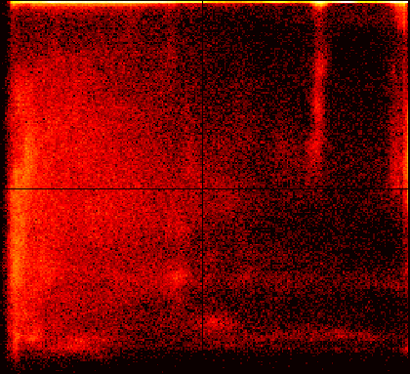
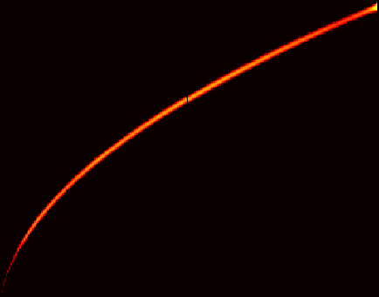
The Joint Histogram
A functional dependency between two variables, p and w, can be detected in their joint histogram P(p,w)
p and w are independent
p and w are strongly dependant
250
250
200
200
150
150
100
100
50
50
50
100
150
200
250
50
100
150
200
250

Slide 15
Joint Histograms and MI
w
H(w)
H(p)
p

Slide 16

Joint Histograms and MI
w
w
w
p
p
p
matching
w
w
p
p
non matching

Slide 17
MI as a Distance Measure:
Properties:
Measures the entropy loss in w given p.
High MI values indicate good match between w and p.
Compensates for non-monotonic mappings
Discriminative.
Sensitive to bin-size / kernel-variance.
Sensitive to small samples.
Very slow to apply.
H(w)
H(p)

Slide 18
Proposed Approach:
Matching by Tone Mapping (MTM)
Properties:
Highly discriminative.
Tone mapping invariant.
Robust to noise and bin-size.
As fast as NCC (~1 convolution).
A natural generalization of the NCC for non-linear mappings.

Slide 19
Matching by Tone Mapping (MTM)
Proposed distance measure:
Note: the division by var(w) avoids the trivial mapping.

Slide 20
How can MTM be calculated efficiently?
Basic Ideas:
Approximate M(p) by a piece-wise constant mapping.
Represent M(p) in a linear form:
Solve for the parameter vector (closed form).
M(p) ≈ S_{p} β
Slice matrix
Parameter vector

Slide 21
MTM as a linear form:
Assume the pattern/window values are restricted to the half open interval [a,b).
We divide [a,b) into k bins α=[α₁,α₂,...,α_{k+1}]
A value z is naturally associated with a single bin:
B(z)=j if z∈[α_{j},α_{j+1})
α₁
α₂
α_{j}
α_{j+1}
α_{k+1}
z

Slide 22
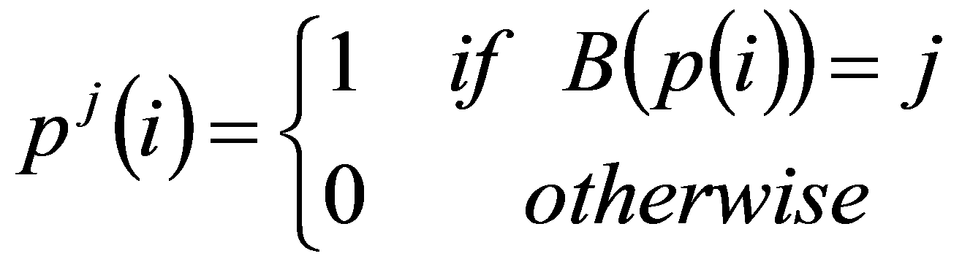
Pattern Slices
We define a pattern slice

Slide 23
Pattern Slices
0
1
2nd slice p²
1st slice p¹
We define a pattern slice

Slide 24
The Slice Matrix
= S_{p}
Raster scanning the slice windows and stacking into a matrix constructs a slice matrix S_{p} =[p¹ p² … p^{k}].

Slide 25
S_{p} α ≈ p
*
≈
The matrix S_{p} is orthogonal: p^{i}⋅p^{j} = |p^{i}| δ_{ij}
Its columns span the space of piecewise constant tone mappings of p:
S _{p} α ≈ p

Slide 26
α
S_{p} ≈
p
β
M(p)
*
≈
Changing the α values to a different vector, β, applies piece-wise tone mapping:
S _{p} β ≈ M(p)

Slide 27
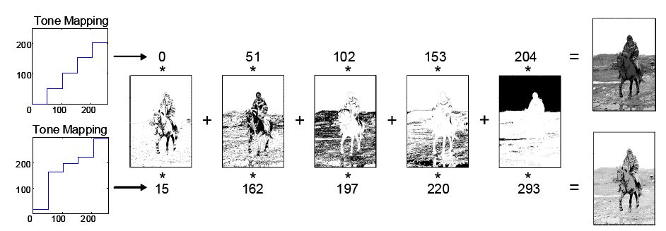


Slide 28
Back to Pattern Matching
Representing tone mapping in a linear form, the MTM distance D(p,w) is defined as:
Since S_{p} is orthogonal ( S^{T}S(i,j)=δ_{ij}|p^{j}| ), the above expression can be minimized in a closed form solution:

Slide 29





D( , )= ( )
•
-( )
p
w
2
•
-( )
2
•
-( )
2
•
…

Slide 30
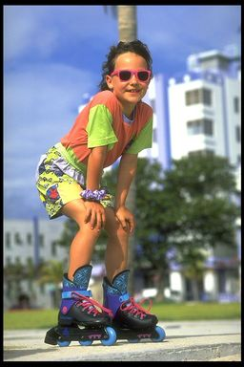

MTM for running windows:
Loop j
*
p:

Slide 31
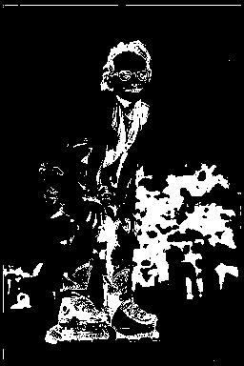
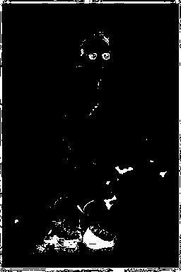
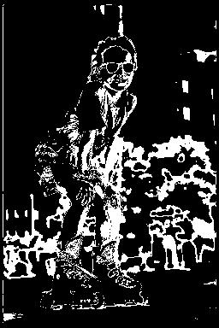

MTM for running windows:
Loop j
*
p:

Slide 32
Complexity
Convolutions can be applied efficiently since p^{j} is sparse.
Convolving with p^{j} requires |p^{j}| operations.
Since p^{i}∩p^{j}=∅ run time for all k sparse convolutions sum up to a single convolution!

Slide 33
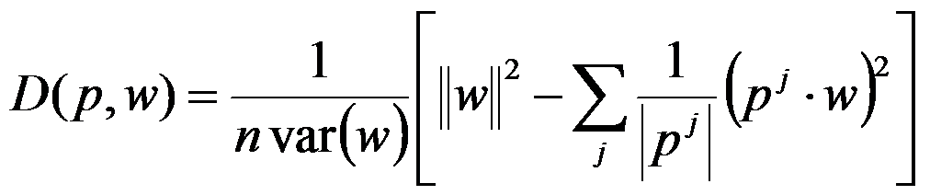
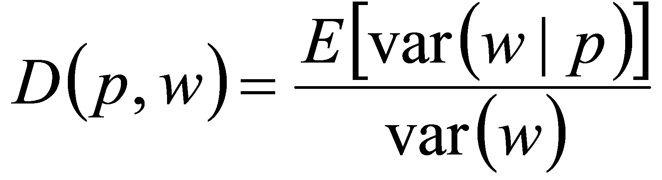
MTM: Statistical Properties
Since we can rewrite:
E(w²|p^{j})
E²(w|p^{j})
n E (var(w|p))
var(w|p^{j})

Slide 34
w
E(w |p=p^{j})
Tone Mapping
var(w |p=p^{j})
E(var(w |p))
p
p^{j}

Slide 35
Observations:
The Law of Total Variance gives:
Therefore
Thus, rather than minimizing E(var(w|p)) we may equivalently maximize var(E(w|p)) .
Correlation Ratio
(Pearson 1930)
FLD
(Fisher 1936)

Slide 36
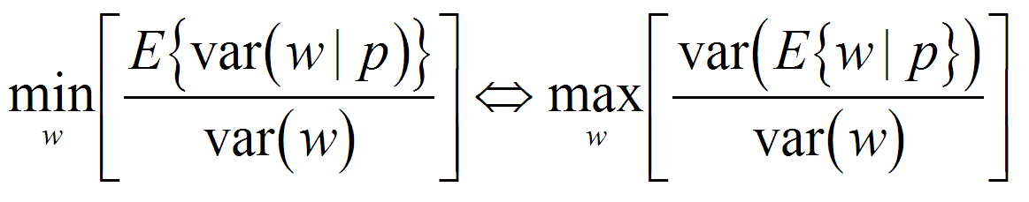
w
E(w |p=p^{j})
var(E(w |p))
Tone Mapping
p
p^{j}

Slide 37
Observations:
The correlation ratio 1-D(w,p) measures the relative reduction in variance of w given p.
Restricting M to be a linear tone mapping: M(z)=az+b, the measure 1-D(w,p) boils down to the Normalized Cross Correlation:

Slide 38
MTM and MI
MTM and MI are similar in spirit.
While MI maximizes the entropy reduction in w given p, MTM maximizes the variance reduction in w given p.
 | MI | MTM
Maximizes | Entropy reduction | Variance reduction
Speed | slow | fast
Bin size | sensitive | insensitive
Small samples | sensitive | insensitive

Slide 39
Results

Slide 40
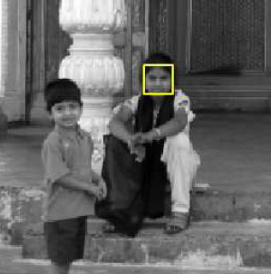
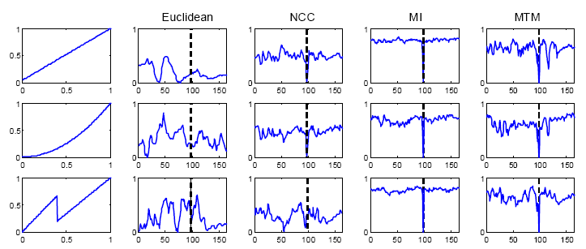
Minimum distance measure for each image column:

Slide 41
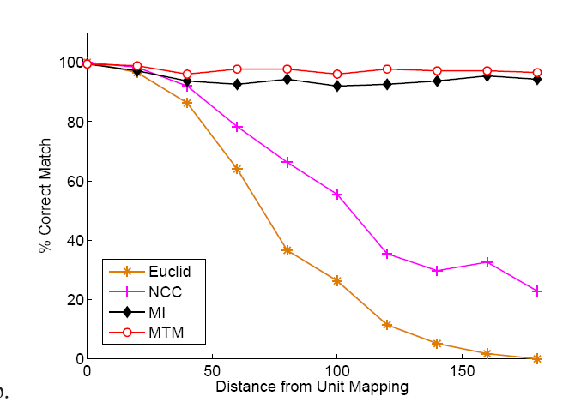
Non Monotonic mappings: Detection rates (over 2000 image pattern pairs) v.s extremity of the applied tone mapping.

Slide 42
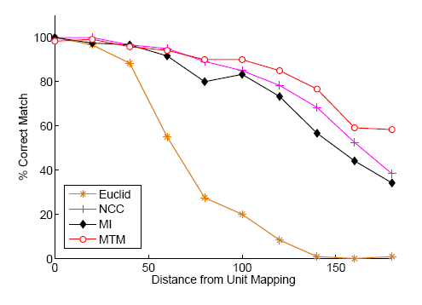
Monotonic mappings: Detection rates (over 2000 image pattern pairs) v.s extremity of the applied tone mapping.

Slide 43
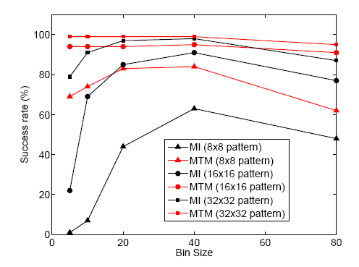
Performance of MI and MTM for various pattern sizes and over various bin-sizes

Slide 44
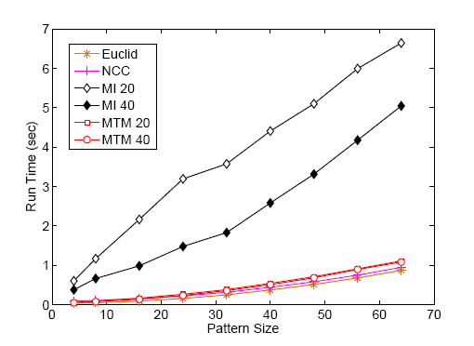
Run time for various pattern size (in 512x512 image)

Slide 45
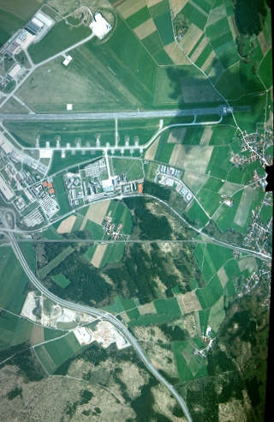
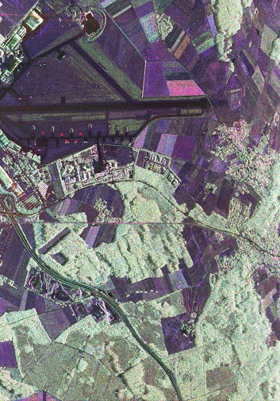
Example Application:
Multi-Modal Registration
Visual
SAR

Slide 46
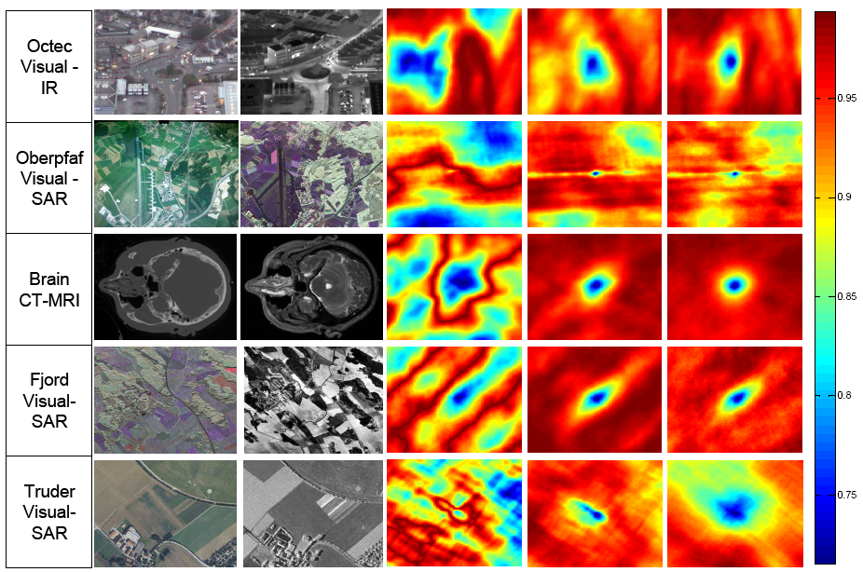
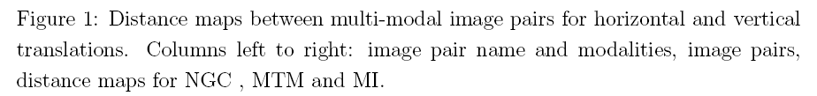

Slide 47
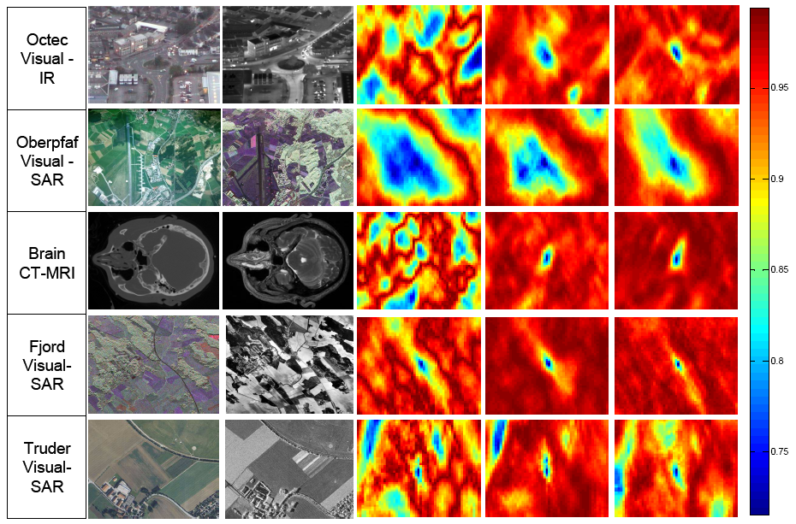
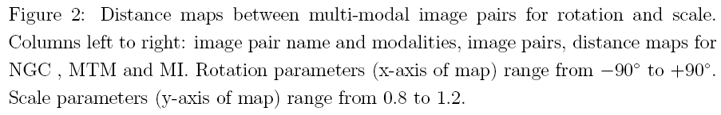

Slide 48
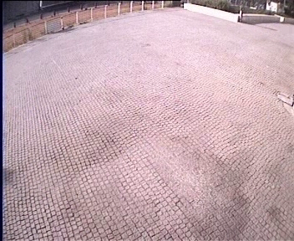
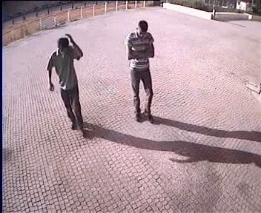
Example Application:
Shadow Detection
How can we distinguish between target and shadow?
Background model
Video frame

Slide 49
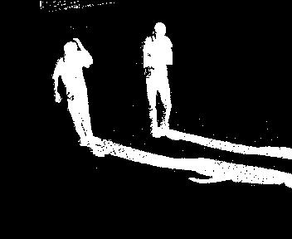
Background Subtraction

Slide 50
Assumption: Shadow areas are functionally dependent on the background model.
Background model
Video frame

Slide 51
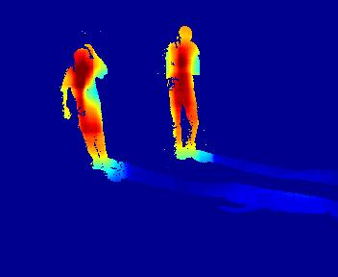
MTM distance

Slide 52
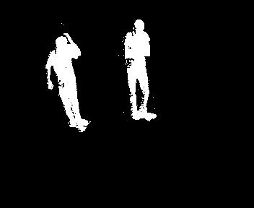
MTM distance

Slide 53
Conclusions:
A new distance measure that accounts for non-linear tone mappings.
An efficient scheme for applying over the entire image (~1 convolution).
Statistically motivated.
A natural generalization of NCC.
Extension: Piecewise-linear tone mapping
  Enables fewer bins
  Robust
  Solving using TDMA
  Requires ~2 convolutions

Slide 54
Thank You

